Slide 1
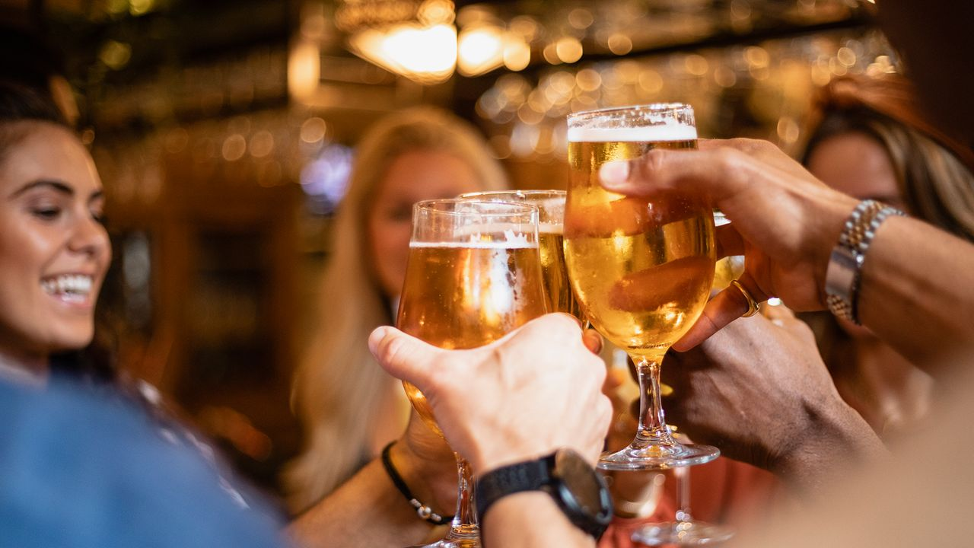

Alcoholic Beverage Occasions – US – 2024
Increasingly casual occasions, consumer concern with lifestyle improvement and the rise of alternatives have all contributed to a shifting drinking landscape.
Sydney Riebe
Analyst - US Food and Drink
June 2024
Read on mintel.com
Notes:
This slide is from Alcoholic Beverage Occasions – US – 2024 (https://clients.mintel.com/content/report/alcoholic-beverage-occasions-us-2024#workspace_SpacesStore_60264eaa-dd1d-48ac-92eb-ea3d20a13eb7)
© 2024 Mintel Group Ltd. All Rights Reserved. Confidential to Mintel.

Slide 2
Table Of Contents
1
EXECUTIVE SUMMARY
5
APPENDIX
2
MARKET DYNAMICS
3
CONSUMER INSIGHTS
4
INNOVATION AND MARKETING TRENDS

Slide 3

Key issues covered in this Report
State of the alcoholic beverage market
Alcoholic beverage attributes
Reasons for alcohol consumption
Alcoholic beverages and activities
Alcoholic beverage attitudes and behaviors
At-home versus away-from home alcohol occasions
Alcoholic beverage innovation and marketing trends
Read on mintel.com
Notes:
This slide is from Alcoholic Beverage Occasions – US – 2024 (https://clients.mintel.com/content/report/alcoholic-beverage-occasions-us-2024#workspace_SpacesStore_d7290020-c78d-4b2a-9eb8-b712c6b1cf3b)
© 2024 Mintel Group Ltd. All Rights Reserved. Confidential to Mintel.

Slide 4
Overview
Consumers are increasingly loosening their connections with traditional alcoholic beverage occasions like relaxation and socializing, especially with the rise of alternatives. By shifting focus to collaboration rather than competition with these alternatives, the beverage landscape can feel more fluid and casual for consumers.
Away-from-home occasions have yet to bounce back since 2020, as consumers now face economic concerns. While strong associations with cocktails and socializing at bars and restaurants remain, the experience must continually feel valuable. Most consumers are drinking alcohol at least once a week, particularly younger, higher-income individuals, but physical, mental, and financial health concerns are prevalent as they aim to improve their overall well-being.
Increased casualization across food and beverage categories is also influencing how consumers approach drinking occasions. While mealtime occasions are less prominent with younger consumers, the emergence of new occasions like snacking, and everyday activities presents opportunities to connect during lower-stakes activities. Alcohol type and brand are not constraining for most consumers, with older individuals more open to trial and pairing suggestions and younger consumers seeking flexibility in mixed ABV and flavor occasions.
Read on mintel.com
Notes:
This slide is from Alcoholic Beverage Occasions – US – 2024 (https://clients.mintel.com/content/report/alcoholic-beverage-occasions-us-2024#workspace_SpacesStore_4f8f60cb-d127-4b52-afa0-37f3a5de171c)
© 2024 Mintel Group Ltd. All Rights Reserved. Confidential to Mintel.

Slide 5

Executive Summary
Read on mintel.com
Notes:
This slide is from Alcoholic Beverage Occasions – US – 2024 (https://clients.mintel.com/content/report/alcoholic-beverage-occasions-us-2024#workspace_SpacesStore_26a601fe-3c4f-4997-a112-dfe5253028ff)
© 2024 Mintel Group Ltd. All Rights Reserved. Confidential to Mintel.

Slide 6
What you need to know
Reasons for drinking alcohol are shifting
Consumers have loosening connections with traditional alcoholic beverage occasions like relaxation and socializing, especially with the rise of alternatives. Shifting focus to collaboration rather than competition with alternatives can help the beverage landscape feel more fluid and casual for consumers.
Format and flavor bring the fun
The success of RTDs has been a perfect storm of casual without sacrificing flavor. To connect, particularly with younger consumers, beer and wine innovations that promote fun can help strengthen their weaker associations like taste and convenience, respectively.
At-home occasions continue to impact foodservice
Away-from-home occasions have yet to bounce back since 2020 as consumers continue to look for ways to save money. While there are still strong associations with cocktails and socialization at bars and restaurants, that experience needs to continually feel valuable.
Read on mintel.com
Notes:
This slide is from Alcoholic Beverage Occasions – US – 2024 (https://clients.mintel.com/content/report/alcoholic-beverage-occasions-us-2024#workspace_SpacesStore_d905c573-5304-4414-bb26-fffc236d5d66)
© 2024 Mintel Group Ltd. All Rights Reserved. Confidential to Mintel.

Slide 7
Consumer trends: key takeaways
Drinking is routine, but comes with concerns
Most consumers are drinking alcohol at least once a week, especially younger, higher income consumers – however, physical, mental and financial health concerns are on consumers' minds as they look to improve their health holistically.
Everyday activities widen occasions
Increased casualization across food and beverage categories is also reflected in when and why consumers are choosing to imbibe. While mealtime occasions are less prominent with younger consumers, the emergence of new occasions like snacking, reading or housework are opportunities to connect during lower-stakes activities.
Consumer flexibility opens doors for guidance and innovation
Alcohol type and brand are occasion agnostic for most consumers, particularly older consumers who may be more open to trial and pairing suggestions. For younger consumers, flexibility in mixed ABV and flavor occasions can be impetus for beverage blurring.
Read on mintel.com
Notes:
This slide is from Alcoholic Beverage Occasions – US – 2024 (https://clients.mintel.com/content/report/alcoholic-beverage-occasions-us-2024#workspace_SpacesStore_cae46759-6729-43ae-ab7f-b3a296f06f64)
© 2024 Mintel Group Ltd. All Rights Reserved. Confidential to Mintel.

Slide 8
Opportunities
Let consumers choose the right ABV for them
Consumers are no longer interested in a one-size-fits-all approach to alcohol. Offering a variety of options in a single purchase can encourage brand trial and foster loyalty. Millennials, in particular, seek both low and high ABV options to accommodate to different moods, needs and individuals within a household or occasion.
Move pairing suggestions beyond meals
There is room for consumer's alcoholic beverage preferences to be further linked to their activities. Marketing and innovation that encourages consumers curate specific occasions can add the enjoyable element that helps brands distinguish their product in a competitive market.
Help consumers lighten up without sacrificing health
Younger consumers are increasingly seeking out beverages that enhance their mood and facilitate social interaction. Incorporating flavors and ingredients with natural health benefits, and exploring collaborations with NA brands can cater to consumers who may choose to switch between alcoholic and NA options during the same event.
Read on mintel.com
Notes:
This slide is from Alcoholic Beverage Occasions – US – 2024 (https://clients.mintel.com/content/report/alcoholic-beverage-occasions-us-2024#workspace_SpacesStore_91533271-8f4b-46b2-be23-5f3bcbc2d1f9)
© 2024 Mintel Group Ltd. All Rights Reserved. Confidential to Mintel.

Slide 9

Market Dynamics
Read on mintel.com
Notes:
This slide is from Alcoholic Beverage Occasions – US – 2024 (https://clients.mintel.com/content/report/alcoholic-beverage-occasions-us-2024#workspace_SpacesStore_1dbae74c-d6fb-4ae1-a550-7df396a90d4a)
© 2024 Mintel Group Ltd. All Rights Reserved. Confidential to Mintel.

Slide 10
Market context
Consumer markets have faced an unprecedented level of turmoil in recent years, from the massive economic disruption in 2020 from COVID to 40-year highs across prices in 2022. Despite that, the US has continued to make significant economic improvements across a key number of areas in the past year. Real GDP (the inflation-adjusted measure of GDP) grew by nearly 2% in Q1 2024. Inflationary pressures have also come a long way since the 40-year highs seen in 2022, as the consumer price index currently sits close to its lowest level in over two years. The labor market remains at historically healthy levels as well, with the unemployment rate standing at 3.9% as of April 2024.
From the time the Federal Reserve began aggressively raising interest rates in 2022, the US has since defied the odds despite many predicting that the country was headed towards a recession. Year-over-year inflation is slowly easing to the central bank’s target rate of 2%, while unemployment remains near historic lows along with consistently healthy economic growth – bringing the US closer to a soft landing.
Read on mintel.com
Notes:
This slide is from Alcoholic Beverage Occasions – US – 2024 (https://clients.mintel.com/content/report/alcoholic-beverage-occasions-us-2024#workspace_SpacesStore_6851b631-7a49-4b86-bc6e-e3a230aabb86)
© 2024 Mintel Group Ltd. All Rights Reserved. Confidential to Mintel.

Slide 11
State of the market
Read on mintel.com
Notes:
This slide is from Alcoholic Beverage Occasions – US – 2024 (https://clients.mintel.com/content/report/alcoholic-beverage-occasions-us-2024#workspace_SpacesStore_caaad6af-24a0-4fdc-8eb8-1391cfd4e892)
© 2024 Mintel Group Ltd. All Rights Reserved. Confidential to Mintel.

Slide 12
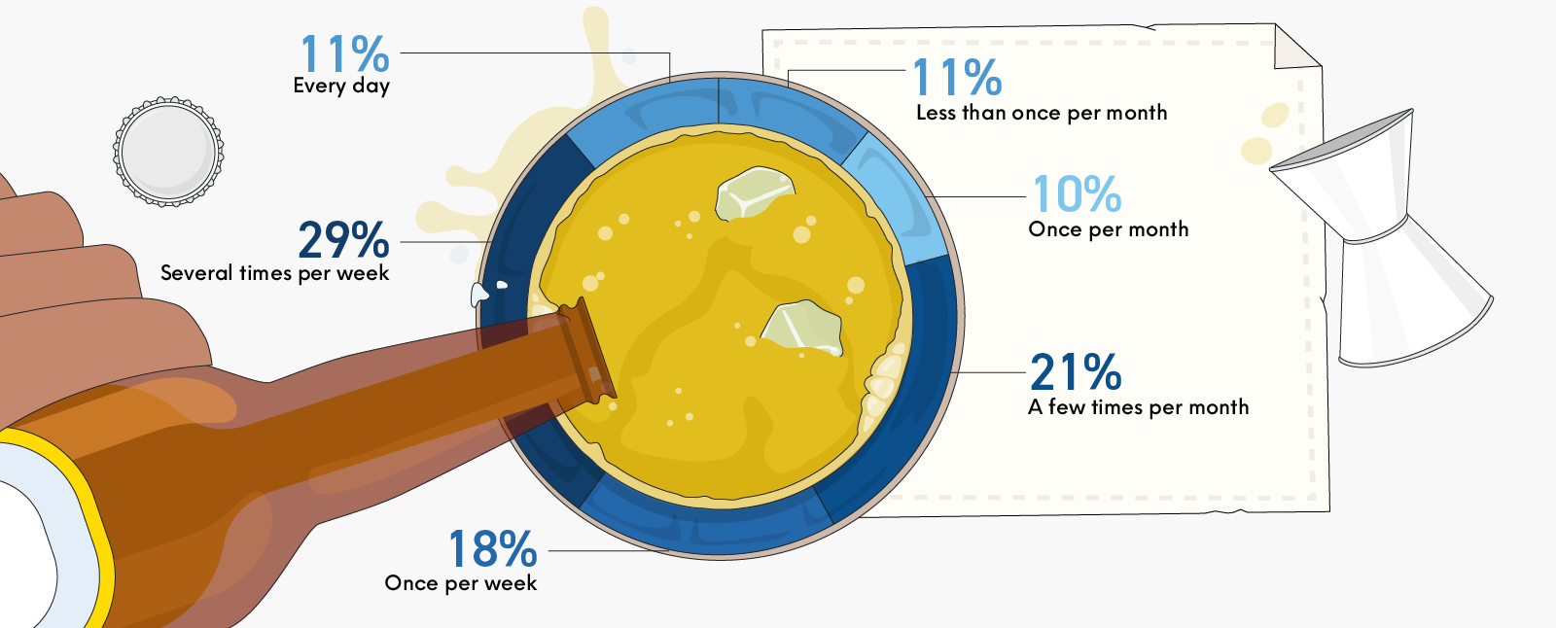
Consumers still find the routine in alcoholic beverage occasions
US: alcohol consumption frequency, % of consumers, 2024
Base: 1,585 internet users aged 22+ who drink alcohol
Source: Kantar Profiles/Mintel, March 2024
Read on mintel.com
Notes:
Source: Kantar Profiles/Mintel, March 2024 [1]
[1] https://data.mintel.com/databook/alcoholic-beverage-occasions-us-2024/#S3
This slide is from Alcoholic Beverage Occasions – US – 2024 (https://clients.mintel.com/content/report/alcoholic-beverage-occasions-us-2024#workspace_SpacesStore_d14662cd-9ca9-4dc4-ba55-c31f7965dd6f)
© 2024 Mintel Group Ltd. All Rights Reserved. Confidential to Mintel.

Slide 13
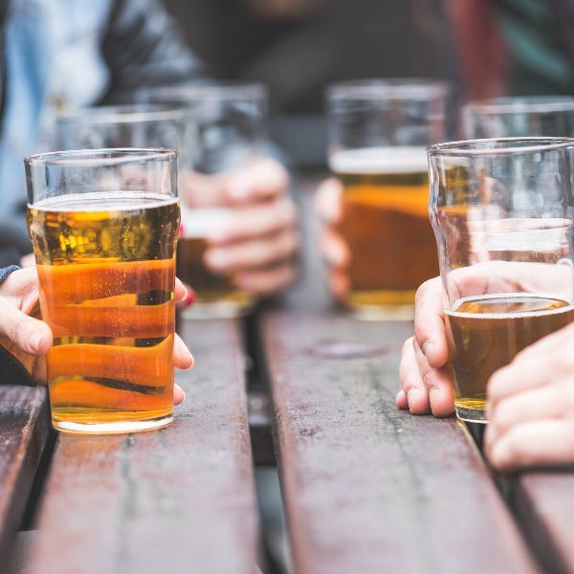
Consumers still find the routine in alcoholic beverage occasions
With over half of alcohol consumers indulging at least weekly, there is a still a strong base of regular consumption, even as health concerns and the availability of alternatives grow. Most frequent consumption is among young, higher income consumers, with 55% consuming alcohol at least several times per week. This demographic cites having fun as the top reason for drinking alcohol, unlike other groups that are more interested in relaxation an indication that social rituals like happy hours and activities and events that include drinking are a big source of entertainment for younger consumers with more disposable income.
Read on mintel.com
Notes:
This slide is from Alcoholic Beverage Occasions – US – 2024 (https://clients.mintel.com/content/report/alcoholic-beverage-occasions-us-2024#workspace_SpacesStore_52ab47f7-a458-44e8-86ee-d81863e721a6)
© 2024 Mintel Group Ltd. All Rights Reserved. Confidential to Mintel.

Slide 14
At home occasions continue to provide more value
Consumers are still showing a preference for at-home drinking, with habits necessitated by the pandemic sticking thanks to current economic concerns. Among those who have increased spirit consumption, 49% cite that they are making more drinks at home and foodservice operators have been feeling the pinch. While beer and wine are still on top for on and off-premise occasions, spirits continue to gain popularity – a sign that operators will have to continually compete to to keep cocktails' strong association with dining out occasions.
Base: 2,000 internet users aged 22+
Source: Kantar Profiles/Mintel, March 2024
Read on mintel.com
Notes:
Source: Kantar Profiles/Mintel, March 2024 [1]
[1] https://data.mintel.com/databook/alcoholic-beverage-occasions-us-2024/#NET_S3_9363
This slide is from Alcoholic Beverage Occasions – US – 2024 (https://clients.mintel.com/content/report/alcoholic-beverage-occasions-us-2024#workspace_SpacesStore_446e7a89-8c3c-4de5-9508-0b995003b7ea)
© 2024 Mintel Group Ltd. All Rights Reserved. Confidential to Mintel.

Slide 15
Market drivers
Read on mintel.com
Notes:
This slide is from Alcoholic Beverage Occasions – US – 2024 (https://clients.mintel.com/content/report/alcoholic-beverage-occasions-us-2024#workspace_SpacesStore_fc01aee4-c4bd-4c2d-9137-be8df152695d)
© 2024 Mintel Group Ltd. All Rights Reserved. Confidential to Mintel.

Slide 16
Consumers are increasingly aware of how alcohol impacts their health...
As more information continues to be available and the conversation surrounding the impact of alcohol on health is more pervasive, consumers are increasingly scrutinizing their relationship with drinking, leading to close to one-third in agreement that they would like to decrease their alcohol consumption. Physical health is not the only concern, as consumers look more holistically at the health of their lifestyle when deciding to cut back, specifically younger consumers, with nearly half of Gen Z consumers are concerned about the impact that alcohol has on their mental health.
58%
of consumers agree that the fastest way to improve health is to drink less alcohol
Read on mintel.com
Notes:
This slide is from Alcoholic Beverage Occasions – US – 2024 (https://clients.mintel.com/content/report/alcoholic-beverage-occasions-us-2024#workspace_SpacesStore_9d66a54e-69e6-4be3-b528-d2d5dbcd45b2)
© 2024 Mintel Group Ltd. All Rights Reserved. Confidential to Mintel.

Slide 17
...but drinking remains a remedy for increased stress
The prevalence of stress, worry and difficulty relaxing have led consumers to look for ways to soften the pressures of everyday life. Among those who have increased spirit consumption, 56% cite that it helps them relax. This number only increases for consumers who are primarily going into work, as they seek a way to wind down after a long day. Brands have the opportunity to bolster associations of relaxation across alcohol types to support stressed out consumers.
Base: 2,000 internet users aged 18+
Source: Kantar Profiles/Mintel, November 2023
Read on mintel.com
Notes:
Source: Kantar Profiles/Mintel, November 2023 [1]
[1] https://data.mintel.com/databook/managing-stress-wellbeing-us-2024/#Q15
This slide is from Alcoholic Beverage Occasions – US – 2024 (https://clients.mintel.com/content/report/alcoholic-beverage-occasions-us-2024#workspace_SpacesStore_c7ae7593-734d-441f-a566-57b8a3f6e322)
© 2024 Mintel Group Ltd. All Rights Reserved. Confidential to Mintel.

Slide 18
Cost is the main deterrent to alcohol consumption
Consumers are still feeling the impact of inflation and high food and beverages prices and discretionary spending continue to be under scrutiny. 48% of consumers who have decreased alcohol consumption are doing so to save money, topping physical and mental health concerns. This has had a larger impact on away-from-home alcohol occasions, as seen by consumer preference for at-home drinking, as well as consumers' change in spending habits in the past year.
71%
of consumers agree that they are still feeling the day-to-day impact of inflation
Read on mintel.com
Notes:
This slide is from Alcoholic Beverage Occasions – US – 2024 (https://clients.mintel.com/content/report/alcoholic-beverage-occasions-us-2024#workspace_SpacesStore_7b1f28df-1869-4d89-a4dd-b5ff90d2f448)
© 2024 Mintel Group Ltd. All Rights Reserved. Confidential to Mintel.

Slide 19
The rise of alcohol alternatives is reinventing drinking occasions
Sober curiosity and the behaviors surrounding the movement have led to and been inspired by innovations in alcohol alternatives, including cannabis products. Alcohol can work with alternatives instead of competing against them, as the same occasion can call for both alcoholic and non-alcohol beverages. While only 22% of consumers say they often switch between alcohol and non-alcoholic beverages during the same occasion, this percentage increases among those who are following or interested in a sober curious lifestyle – an indication that moderation can benefit both categories. Additionally, among consumers who have used or are interested in trying drinkable cannabis, one-third are interested in doing so via an alcoholic beverage.
Read on mintel.com
Notes:
This slide is from Alcoholic Beverage Occasions – US – 2024 (https://clients.mintel.com/content/report/alcoholic-beverage-occasions-us-2024#workspace_SpacesStore_5362fa11-e7cf-4534-b3c1-e43ef6ec38ad)
© 2024 Mintel Group Ltd. All Rights Reserved. Confidential to Mintel.

Slide 20
Market size
Read on mintel.com
Notes:
This slide is from Alcoholic Beverage Occasions – US – 2024 (https://clients.mintel.com/content/report/alcoholic-beverage-occasions-us-2024#workspace_SpacesStore_df1518f8-f9b6-47c7-ab8e-b1f3bec72630)
© 2024 Mintel Group Ltd. All Rights Reserved. Confidential to Mintel.

Slide 21
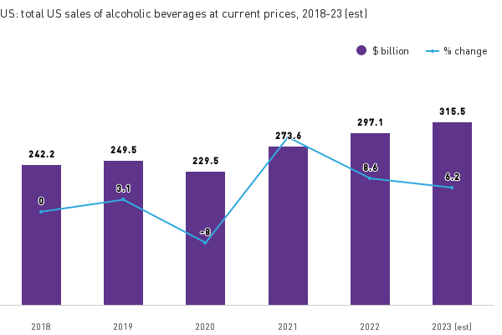
Alcohol sales begin to level off as consumers reassess value
The total alcohol market has seen sales begin to flatten (inflation adjusted) after a huge bounce back post 2020. The success of premium spirits, fun and flavorful RTDs and at-home occasions is in contrast with the struggle of wine to remain relevant and for away-from-home occasions to feel worth it. As brands and operators adjust to changing consumer needs, how alcohol fits into occasions and experiences will continue to drive which categories and locations steal share.
Note: includes both on-premise and off-premise sales
Source: based on Bureau of Economic Analysis; Bureau of Labor Statistics, Consumer Expenditure Survey; USDA Economic Research Service/Mintel
Read on mintel.com
Notes:
Note: includes both on-premise and off-premise sales
Source: based on Bureau of Economic Analysis; Bureau of Labor Statistics, Consumer Expenditure Survey; USDA Economic Research Service/Mintel
This slide is from Alcoholic Beverage Occasions – US – 2024 (https://clients.mintel.com/content/report/alcoholic-beverage-occasions-us-2024#workspace_SpacesStore_f4f4613f-c102-45ef-954d-5041dadeb911)
© 2024 Mintel Group Ltd. All Rights Reserved. Confidential to Mintel.

Slide 22
Retail sales of alcoholic beverages at current prices
US: total US sales of alcoholic beverages, at current prices, 2018-23 (est)
Year | $ billion | % change | Index (2018 = 100) | Index (2023 = 100)
2018 | 242.2 | - | 100 | 77
2019 | 249.5 | 3.1% | 103 | 79
2020 | 229.5 | -8.0% | 95 | 73
2021 | 273.6 | 19.2% | 113 | 87
2022 | 297.1 | 8.6% | 123 | 94
2023 | 315.5 | 6.2% | 130 | 100
Note:Includes both on-premise and off-premise sales
Source: based on Bureau of Economic Analysis; Bureau of Labor Statistics, Consumer Expenditure Survey; USDA Economic Research Service/Mintel
Read on mintel.com
Notes:
Source: based on Bureau of Economic Analysis; Bureau of Labor Statistics, Consumer Expenditure Survey; USDA Economic Research Service/Mintel
This slide is from Alcoholic Beverage Occasions – US – 2024 (https://clients.mintel.com/content/report/alcoholic-beverage-occasions-us-2024#workspace_SpacesStore_669f879a-fb14-4fb0-be72-16fa92345841)
© 2024 Mintel Group Ltd. All Rights Reserved. Confidential to Mintel.

Slide 23
Retail sales of alcoholic beverages at inflation-adjusted prices
US: total US sales of alcoholic beverages, at inflation-adjusted prices, 2018-23 (est)
Year | $ billion | % change | Index (2018 = 100) | Index (2023 = 100)
2018 | 293.8 | - | 100 | 93
2019 | 297.3 | 1.2% | 101 | 94
2020 | 270.1 | -9.1% | 92 | 86
2021 | 307.5 | 13.8% | 105 | 97
2022 | 309.3 | 0.6% | 105 | 98
2023 (est) | 315.5 | 2.0% | 107 | 100
Note:Includes both on-premise and off-premise sales
Source: based on Bureau of Economic Analysis; Bureau of Labor Statistics, Consumer Expenditure Survey; USDA Economic Research Service/Mintel
Read on mintel.com
Notes:
Source: based on Bureau of Economic Analysis; Bureau of Labor Statistics, Consumer Expenditure Survey; USDA Economic Research Service/Mintel
This slide is from Alcoholic Beverage Occasions – US – 2024 (https://clients.mintel.com/content/report/alcoholic-beverage-occasions-us-2024#workspace_SpacesStore_53f30368-fa1a-4c89-8f61-649f94ab1ce5)
© 2024 Mintel Group Ltd. All Rights Reserved. Confidential to Mintel.

Slide 24
Market segmentation
Read on mintel.com
Notes:
This slide is from Alcoholic Beverage Occasions – US – 2024 (https://clients.mintel.com/content/report/alcoholic-beverage-occasions-us-2024#workspace_SpacesStore_a74d11cd-3287-44e1-b1c7-77cb9f0b2a0e)
© 2024 Mintel Group Ltd. All Rights Reserved. Confidential to Mintel.

Slide 25
Beer steals share from wine, thanks to casualized occasions
Wine's identity crisis, especially among younger consumers has led to a decrease in share among total alcohol market value. Already highly associated with being casual, beer has benefited from wine's difficulty in feeling accessible and modern and taken up most of the losses over five years as consumers increasingly look for fun and convenient drinking options.
Note:includes both on-premise and off-premise sales
Source: based on Bureau of Economic Analysis; Bureau of Labor Statistics, Consumer Expenditure Survey; USDA Economic Research Service/Mintel
Read on mintel.com
Notes:
Source: based on Bureau of Economic Analysis; Bureau of Labor Statistics, Consumer Expenditure Survey; USDA Economic Research Service/Mintel
This slide is from Alcoholic Beverage Occasions – US – 2024 (https://clients.mintel.com/content/report/alcoholic-beverage-occasions-us-2024#workspace_SpacesStore_4ae57e77-1e2e-4590-8b1d-dad65656ee2a)
© 2024 Mintel Group Ltd. All Rights Reserved. Confidential to Mintel.

Slide 26
On-premise struggles to return to pre-2020 levels
At-home occasions continue to steal share from on-premise, as consumers struggle to find value comparable to the relative affordability and convenience of drinking at home. While cocktails are still winning away-from-home occasions, consumer interest in creating cocktails at home can be a threat. Operators will have to push experiential value that can delivery beyond what consumers can do at home to compete.
Note:includes both on-premise and off-premise sales
Source: based on Bureau of Economic Analysis; Bureau of Labor Statistics, Consumer Expenditure Survey; USDA Economic Research Service/Mintel
Read on mintel.com
Notes:
Source: based on Bureau of Economic Analysis; Bureau of Labor Statistics, Consumer Expenditure Survey; USDA Economic Research Service/Mintel
This slide is from Alcoholic Beverage Occasions – US – 2024 (https://clients.mintel.com/content/report/alcoholic-beverage-occasions-us-2024#workspace_SpacesStore_890e1d7b-e6e0-4d5d-a0d9-285ad324c79e)
© 2024 Mintel Group Ltd. All Rights Reserved. Confidential to Mintel.

Slide 27
Consumer Insights
Read on mintel.com
Notes:
This slide is from Alcoholic Beverage Occasions – US – 2024 (https://clients.mintel.com/content/report/alcoholic-beverage-occasions-us-2024#workspace_SpacesStore_97442881-dda6-424b-a9ed-88516858ee9c)
© 2024 Mintel Group Ltd. All Rights Reserved. Confidential to Mintel.

Slide 28
Consumer fast facts
Consumers ID different leading attributes for alcohol types
Beer leads in casual (40%), but struggles with taste among Gen Z (19%)
Wine leads in relaxing (43%), RTDs win convenience (32%) and cocktails win in taste (43%)
Most consumers are flexible when it comes to comes to alcohol type and brand choice
44% agree that some alcohol types are only for certain occasions
33% agree some alcohol brands are only for certain occasion
But less flexible when it comes to integrating NA into the occasion
22% often switch between alcoholic and NA beverages during the same occasion
15% look for the same flavors in NA beverages as they do alcoholic ones
Younger consumers drink around dayparts and ABVs
32% of Gen Z prefer to drink in the evening (compared to 48% total)
Millennials look for high ABV (39%) low ABV (29%) alcoholic beverages for at-home occasions
Read on mintel.com
Notes:
This slide is from Alcoholic Beverage Occasions – US – 2024 (https://clients.mintel.com/content/report/alcoholic-beverage-occasions-us-2024#workspace_SpacesStore_514e91e5-6d84-433d-9e5b-1af65f5185b9)
© 2024 Mintel Group Ltd. All Rights Reserved. Confidential to Mintel.

Slide 29
Alcoholic beverage attributes
Read on mintel.com
Notes:
This slide is from Alcoholic Beverage Occasions – US – 2024 (https://clients.mintel.com/content/report/alcoholic-beverage-occasions-us-2024#workspace_SpacesStore_8a31435c-b104-4c5b-ab20-ab2b1c75b690)
© 2024 Mintel Group Ltd. All Rights Reserved. Confidential to Mintel.

Slide 30
Top attributes set the scene for occasions
How consumers perceive alcohol types can help brands lean into occasions and activities that feel naturally suited to those associations. Additionally, while no alcohol type can be one size fits all, borrowing from the strengths of other beverage types can help inspire consumers to expand their perceptions – like introducing wine formats that feel as fun and convenient as RTDs.
US: alcoholic beverage attributes, 2024
Alcoholic beverage | Leading attributes
Beer | Casual, good for at-home
Wine | Relaxing, tastes good
RTDs | Convenient, fun
Cocktails/mixed drinks | Tastes good, good to order out
Spirits (straight or on the rocks) | Good in moderation, premium
Read on mintel.com
Notes:
This slide is from Alcoholic Beverage Occasions – US – 2024 (https://clients.mintel.com/content/report/alcoholic-beverage-occasions-us-2024#workspace_SpacesStore_8958b618-6122-4641-b759-50b94d6eab7d)
© 2024 Mintel Group Ltd. All Rights Reserved. Confidential to Mintel.

Slide 31
Beer and wine struggle with taste perceptions among Gen Z
In order to remain relevant with younger generations, beer and wine will need to focus on flavor – especially as Gen Z associates both as expensive compared to other generations. Brands and operators can look to RTDs and mixers for flavor, color and format inspiration to add value and shift traditional perceptions that may be fizzling out.
Tastes good
Base: 1,585 internet users aged 22+ who drink alcohol
Source: Kantar Profiles/Mintel, March 2024
Read on mintel.com
Notes:
Source: Kantar Profiles/Mintel, March 2024 [1]
[1] https://data.mintel.com/databook/alcoholic-beverage-occasions-us-2024/question/Q13/code/11?country=3&significance=show&d=generation&presentation=graphs&flipped=1&Q13_flipped_off=4&Q13_flipped_off=5&Q13_flipped_off=6&Q13_flipped_off=7&Q13_flipped_off=8&Q13_flipped_off=9&Q13_flipped_off=10#Q13
This slide is from Alcoholic Beverage Occasions – US – 2024 (https://clients.mintel.com/content/report/alcoholic-beverage-occasions-us-2024#workspace_SpacesStore_23cb5e9d-e347-41ab-9900-d669b370f473)
© 2024 Mintel Group Ltd. All Rights Reserved. Confidential to Mintel.

Slide 32
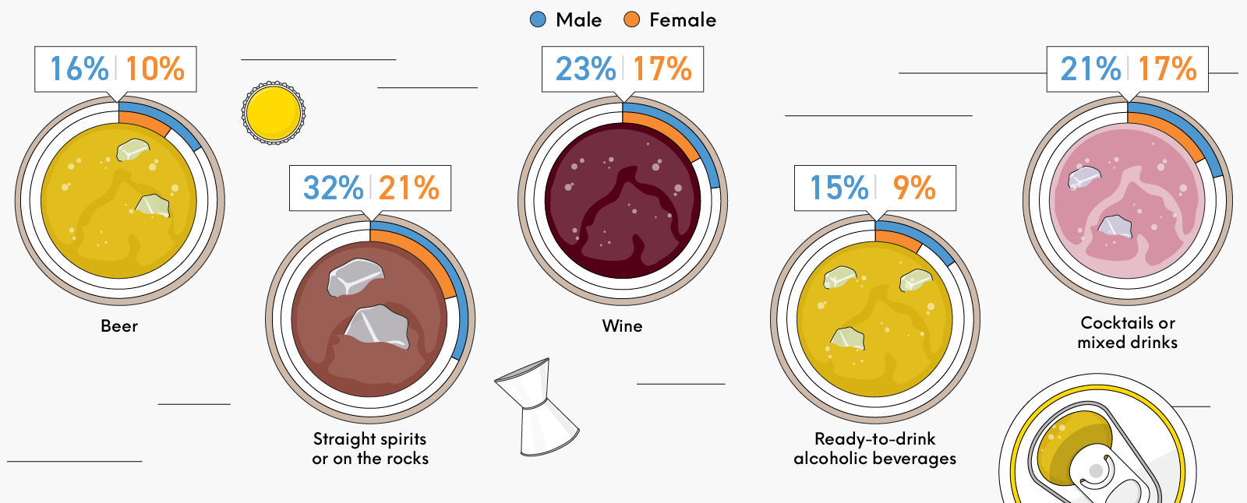
Female consumers need help connecting with premium
The relative disconnect between female consumers and premium associations presents an opportunity to tailor marketing, collaborations and menu items to women. Female consumers are not only highly engaged with premium when it comes to spirits and cocktail creations at home but are also more likely than men to order premium options and try new cocktails away-from-home.
US: alcoholic beverage attributes – Premium, % of consumers by gender, 2024
Base: 1,585 internet users aged 22+ who drink alcohol
Source: Kantar Profiles/Mintel, March 2024
Read on mintel.com
Notes:
Source: Kantar Profiles/Mintel, March 2024 [1]
[1] https://data.mintel.com/databook/alcoholic-beverage-occasions-us-2024/question/Q13/code/2?country=3&d=gender&significance=show#Q13
This slide is from Alcoholic Beverage Occasions – US – 2024 (https://clients.mintel.com/content/report/alcoholic-beverage-occasions-us-2024#workspace_SpacesStore_7c89ae37-e12a-4389-b793-9c9ae2240aa3)
© 2024 Mintel Group Ltd. All Rights Reserved. Confidential to Mintel.

Slide 33
Reasons for alcohol consumption
Read on mintel.com
Notes:
This slide is from Alcoholic Beverage Occasions – US – 2024 (https://clients.mintel.com/content/report/alcoholic-beverage-occasions-us-2024#workspace_SpacesStore_78888509-70c4-451c-86a5-43daf0ca9dc5)
© 2024 Mintel Group Ltd. All Rights Reserved. Confidential to Mintel.

Slide 34
Alcoholic beverage occasions have weakened in the past five years
The dampening correlation between alcohol and occasions suggests that it may be time for brands and operators to refresh how they inspire consumers. While alcohol alternatives and cannabis may be stealing relaxing and unwinding occasions, working alongside instead of in direct competition can appeal to consumers who are cutting back or pacing themselves. With stress reduction a motivator for alcohol consumption, reframing relaxing occasions to focus on mood improvement can deliver a small escape for consumers without completely ignoring health concerns.
Base: 1,703 internet users aged 22+ who drink any of the alcohol types measured; 1,585 internet users aged 22+ who drink alcohol
Source: Kantar Profiles/Mintel, July 2019, March 2024
Read on mintel.com
Notes:
Source: Kantar Profiles/Mintel, July 2019 [1], March 2024 [2]
[1] https://data.mintel.com/databook/918324/#Q3
[2] https://data.mintel.com/databook/alcoholic-beverage-occasions-us-2024/#Q14
This slide is from Alcoholic Beverage Occasions – US – 2024 (https://clients.mintel.com/content/report/alcoholic-beverage-occasions-us-2024#workspace_SpacesStore_704f84db-0e79-4f3a-b24b-67407819fd4d)
© 2024 Mintel Group Ltd. All Rights Reserved. Confidential to Mintel.

Slide 35
Help consumers unwind at happy hour
While fewer consumers are looking to alcohol to relax and unwind, there is still a solid base among those who are leaving home for work. Operators can prioritize the after work crowd by making happy hour pricing straightforward with exciting options, allowing for an easy experience that can become routine. Evening occasions are preferable for consumers looking to alcohol to unwind, and they are particularly more likely to seek a happy hour out of the house. Additionally, 68% of consumers agree that happy hour is a great way to try new drinks they haven't ordered before and can lead to menu exploration.
drink alcohol to relax/unwind
65%
of consumers who entirely go into work
Read on mintel.com
Notes:
This slide is from Alcoholic Beverage Occasions – US – 2024 (https://clients.mintel.com/content/report/alcoholic-beverage-occasions-us-2024#workspace_SpacesStore_c3a899df-fcd4-4aa3-9898-8d50121ecd92)
© 2024 Mintel Group Ltd. All Rights Reserved. Confidential to Mintel.

Slide 36
Focus on infusing fun for younger consumers
Meeting younger consumers where they are when it comes to reasons for drinking presents an opportunity to showcase how products can add to the fun. Product and menu innovation that look to drinks that are most associated with fun, like cocktails can help less "fun" beverages like wine surprise and delight. 37% of 22-34 yo consumers agree that sparkling wine is more refreshing than regular wine and nearly half agree that sparkling wine makes a good cocktail ingredient – a prime example on how a traditional category can appeal to younger generations.
Base: 1,585 internet users aged 22+ who drink alcohol
Source: Kantar Profiles/Mintel, March 2024
Read on mintel.com
Notes:
Source: Kantar Profiles/Mintel, March 2024 [1]
[1] https://data.mintel.com/databook/alcoholic-beverage-occasions-us-2024/question/Q14?country=3&d=generation#Q14
This slide is from Alcoholic Beverage Occasions – US – 2024 (https://clients.mintel.com/content/report/alcoholic-beverage-occasions-us-2024#workspace_SpacesStore_ffb812bb-32ab-40f4-8538-5d10e43b0abc)
© 2024 Mintel Group Ltd. All Rights Reserved. Confidential to Mintel.

Slide 37
Alcoholic beverages and activities
Read on mintel.com
Notes:
This slide is from Alcoholic Beverage Occasions – US – 2024 (https://clients.mintel.com/content/report/alcoholic-beverage-occasions-us-2024#workspace_SpacesStore_1b02c667-b9f0-4fcf-8280-6b2d410e70d0)
© 2024 Mintel Group Ltd. All Rights Reserved. Confidential to Mintel.

Slide 38
Younger consumers add alcohol to more casual occasions
While older consumers lead traditional drinking occasions like socializing and dining, the shift toward laid back and lower stakes occasions is an opportunity for brands to help younger consumers take their mind of things, specifically at-home. The popularity of RTDs among younger consumers paired with their casual and relaxing connotations is an example of how ease of consumption without sacrificing flavor can fit seamlessly into everyday activities like housework or a happy hour/snacking hour combination.
Base: 1,585 internet users aged 22+ who drink alcohol
Source: Kantar Profiles/Mintel, March 2024
Read on mintel.com
Notes:
Source: Kantar Profiles/Mintel, March 2024 [1]
[1] https://data.mintel.com/databook/alcoholic-beverage-occasions-us-2024/question/Q15?country=3&d=generation&significance=show#Q15
This slide is from Alcoholic Beverage Occasions – US – 2024 (https://clients.mintel.com/content/report/alcoholic-beverage-occasions-us-2024#workspace_SpacesStore_02ba0422-a221-4be8-ad1d-a454d927c71d)
© 2024 Mintel Group Ltd. All Rights Reserved. Confidential to Mintel.

Slide 39

Connect what consumers are doing and drinking at home
Marketing and collaborations can strengthen how consumers pair drinks with their everyday chores and hobbies.
RTDs and housework
WINE and reading
BEER and video games
76%
71%
70%
of consumers who drink alcohol while doing housework also drink RTDs
of consumers who drink alcohol while reading also drink wine
of consumers who drink alcohol while playing video games also drink beer
Source: Kantar Profiles/Mintel, March 2024
Read on mintel.com
Notes:
Source: Kantar Profiles/Mintel, March 2024 [1]
[1] https://data.mintel.com/databook/alcoholic-beverage-occasions-us-2024/crosstab#At-home-alcoholic-beverage-consumption,-by-alcoholic-beverages-and-activities,-2024
This slide is from Alcoholic Beverage Occasions – US – 2024 (https://clients.mintel.com/content/report/alcoholic-beverage-occasions-us-2024#workspace_SpacesStore_4056008d-3e0e-4702-b768-4e249daf4f27)
© 2024 Mintel Group Ltd. All Rights Reserved. Confidential to Mintel.

Slide 40
Give older women a space to socialize
Foodservice operators have the opportunity to connect with older female consumers and their love of social drinking occasions. Events and offerings that cater to their top beverage preferences like wine and suggesting food pairings can bring them in not only for drinks but also for a full dining experience, as 38% agree that it is important that an alcoholic beverage complements food. Additionally, this demographic is less stringent about how alcohol types and brands match occasions, an opportunity for operators to introduce new varietals, wineries and even other beverage types.
Female consumers aged 55+
72%
socialize with friends/family while consuming alcohol
Read on mintel.com
Notes:
This slide is from Alcoholic Beverage Occasions – US – 2024 (https://clients.mintel.com/content/report/alcoholic-beverage-occasions-us-2024#workspace_SpacesStore_f46bf643-1559-4a22-9fc6-984030ce9127)
© 2024 Mintel Group Ltd. All Rights Reserved. Confidential to Mintel.

Slide 41
Alcoholic beverage attitudes
Read on mintel.com
Notes:
This slide is from Alcoholic Beverage Occasions – US – 2024 (https://clients.mintel.com/content/report/alcoholic-beverage-occasions-us-2024#workspace_SpacesStore_3eb3cdcc-b4dd-475f-907e-d7ebdf0346e1)
© 2024 Mintel Group Ltd. All Rights Reserved. Confidential to Mintel.

Slide 42
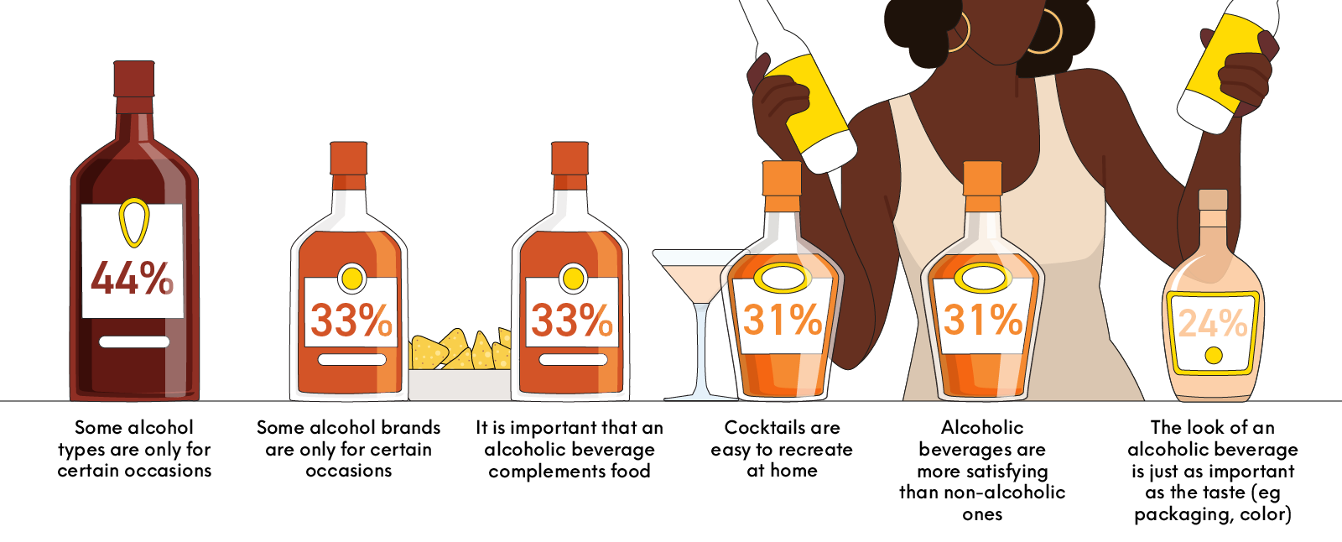
The majority of consumers are flexible when it comes to alcohol and occasions
US: alcoholic beverage attitudes, % of consumers, 2024
Base: 1,585 internet users aged 22+ who drink alcohol
Source: Kantar Profiles/Mintel, March 2024
Read on mintel.com
Notes:
Source: Kantar Profiles/Mintel, March 2024 [1]
[1] https://data.mintel.com/databook/alcoholic-beverage-occasions-us-2024/#Q16
This slide is from Alcoholic Beverage Occasions – US – 2024 (https://clients.mintel.com/content/report/alcoholic-beverage-occasions-us-2024#workspace_SpacesStore_b44b1f14-0546-4777-a1de-f2fd97a88259)
© 2024 Mintel Group Ltd. All Rights Reserved. Confidential to Mintel.

Slide 43
The majority of consumers are flexible when it comes to alcohol and occasions
Brands and operators have room to strengthen and widen beverage trial occasions, especially among older consumers. While groups like Millennials are more fixated with perfecting the occasion, Baby Boomers are more likely to participate in traditional evening and mealtime occasions where they can be influenced by food pairings, descriptive tasting notes and are more lenient in their consideration of brands across occasions, leading to an openness to trial.
Base: 1,585 internet users aged 22+ who drink alcohol
Source: Kantar Profiles/Mintel, March 2024
Read on mintel.com
Notes:
Source: Kantar Profiles/Mintel, March 2024 [1]
[1] https://data.mintel.com/databook/alcoholic-beverage-occasions-us-2024/#Q16
This slide is from Alcoholic Beverage Occasions – US – 2024 (https://clients.mintel.com/content/report/alcoholic-beverage-occasions-us-2024#workspace_SpacesStore_3022269f-eb17-4bf3-b6e5-3849e101cca2)
© 2024 Mintel Group Ltd. All Rights Reserved. Confidential to Mintel.

Slide 44
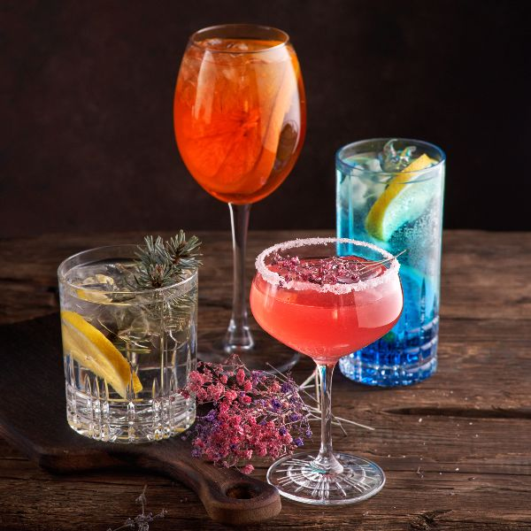
Help Gen Z make the most of their cocktail experience
Brands can connect with Gen Z consumers through aesthetics, appealing to the nearly one-third agree that the look of an alcoholic beverage is just as important as taste. Already highly engaged with at-home cocktail occasions via their interest in experimentation, collection and education, there is an opportunity to not only improve the look of products but to more holistically market an atmosphere that promotes the fun of the entire experience including glassware, ice, décor and snack pairings.
Read on mintel.com
Notes:
This slide is from Alcoholic Beverage Occasions – US – 2024 (https://clients.mintel.com/content/report/alcoholic-beverage-occasions-us-2024#workspace_SpacesStore_7e885480-4f79-43f9-817f-381bae571f73)
© 2024 Mintel Group Ltd. All Rights Reserved. Confidential to Mintel.

Slide 45
Alcoholic beverage behaviors
Read on mintel.com
Notes:
This slide is from Alcoholic Beverage Occasions – US – 2024 (https://clients.mintel.com/content/report/alcoholic-beverage-occasions-us-2024#workspace_SpacesStore_9cdfaa64-85dd-47e5-94f4-70cd925a4992)
© 2024 Mintel Group Ltd. All Rights Reserved. Confidential to Mintel.

Slide 46
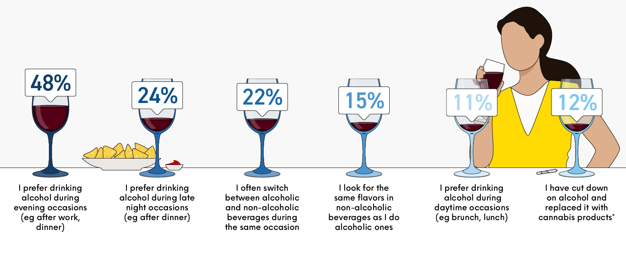
Occasions and flavor are alcohol-specific for most consumers, for now
US: alcoholic beverage behaviors, % of consumers. 2024
Base: 1,585 internet users aged 22+ who drink alcohol; *745 internet users aged 22+ who drink alcohol and live in a state where recreational cannabis is legal
Source: Kantar Profiles/Mintel, March 2024
Read on mintel.com
Notes:
Source: Kantar Profiles/Mintel, March 2024 [1]
[1] https://data.mintel.com/databook/alcoholic-beverage-occasions-us-2024/#Q17
This slide is from Alcoholic Beverage Occasions – US – 2024 (https://clients.mintel.com/content/report/alcoholic-beverage-occasions-us-2024#workspace_SpacesStore_593420f0-d48a-45df-8aeb-ac1a90e9d419)
© 2024 Mintel Group Ltd. All Rights Reserved. Confidential to Mintel.

Slide 47
Occasions and flavor are alcohol-specific for most consumers, for now
While alcohol alternatives and moderation conversations are on the rise, the vast majority of consumers still view drinking occasions and the flavors they are choosing as distinct to alcohol. The distinction does weaken with younger consumers, an indication that brands can get ahead of the shift and begin to consider versatile, refreshing flavors (like RTDs have accomplished) and sessionability either through low ABV or NA product extensions.
Base: 1,585 internet users aged 22+ who drink alcohol; * 745 internet users aged 22+ who drink alcohol and live in a state where recreational cannabis is legal
Source: Kantar Profiles/Mintel, March 2024
Read on mintel.com
Notes:
Source: Kantar Profiles/Mintel, March 2024 [1]
[1] https://data.mintel.com/databook/alcoholic-beverage-occasions-us-2024/#Q17
This slide is from Alcoholic Beverage Occasions – US – 2024 (https://clients.mintel.com/content/report/alcoholic-beverage-occasions-us-2024#workspace_SpacesStore_3f21a8eb-526f-4fa7-bb11-6a140b713c01)
© 2024 Mintel Group Ltd. All Rights Reserved. Confidential to Mintel.

Slide 48
Daypart flexibility can modernize traditional drink associations
With younger consumers less attached to the traditional evening drinking occasion, beer and wine have the opportunity for a renaissance based on daytime fun. Sparkling wine and wine based cocktails are already being recognized as more fun by younger consumers, and 29% of beer drinkers connect the beverage with daytime activities and even more with outdoor activities. Brands and operators can push brunch and patio occasions that refresh day drinking.
Base: 1,585 internet users aged 18+ who drink alcohol
Source: Kantar Profiles/Mintel, March 2024
Read on mintel.com
Notes:
Source: Kantar Profiles/Mintel, March 2024 [1]
[1] https://data.mintel.com/databook/alcoholic-beverage-occasions-us-2024/question/Q17?country=3&significance=show&d=generation&presentation=tables#Q17
This slide is from Alcoholic Beverage Occasions – US – 2024 (https://clients.mintel.com/content/report/alcoholic-beverage-occasions-us-2024#workspace_SpacesStore_5f864683-ca77-4944-83a6-080b365e0233)
© 2024 Mintel Group Ltd. All Rights Reserved. Confidential to Mintel.

Slide 49
At-home versus away-from-home alcoholic beverage behaviors
Read on mintel.com
Notes:
This slide is from Alcoholic Beverage Occasions – US – 2024 (https://clients.mintel.com/content/report/alcoholic-beverage-occasions-us-2024#workspace_SpacesStore_1d4973a6-540c-4fb7-b9f8-d9f5e7b6dec3)
© 2024 Mintel Group Ltd. All Rights Reserved. Confidential to Mintel.

Slide 50
Experience still drives AFH drinking occasions and new trial
Despite pulling back from bars and restaurants due to economic concerns, consumers still prefer to get out of the house for new brands, flavors, cocktails and being social.
Base: 1,585 internet users aged 22+ who drink alcohol
Source: Kantar Profiles/Mintel, March 2024
Read on mintel.com
Notes:
Source: Kantar Profiles/Mintel, March 2024 [1]
[1] https://data.mintel.com/databook/alcoholic-beverage-occasions-us-2024/#Q18
This slide is from Alcoholic Beverage Occasions – US – 2024 (https://clients.mintel.com/content/report/alcoholic-beverage-occasions-us-2024#workspace_SpacesStore_5f1a3b84-8713-408c-97b4-f54b6e2667d8)
© 2024 Mintel Group Ltd. All Rights Reserved. Confidential to Mintel.

Slide 51
Women get in the spirit in bars and restaurants
While women are drinking spirits at lower rates than men, their interest in trying cocktails away from home is an opportunity for operators to design menu items that allow female consumers to explore, not only across spirit types and brands, but with unique flavor combinations. More open and influenced by in-person recommendations, staff suggestions are a great way to open up the conversation and promote trial and can payoff with premium upgrades, something female consumers are more likely to do when going out.
prefer to try a new cocktail type aFH
46%
of female consumers compared to 41% of men
Read on mintel.com
Notes:
This slide is from Alcoholic Beverage Occasions – US – 2024 (https://clients.mintel.com/content/report/alcoholic-beverage-occasions-us-2024#workspace_SpacesStore_bc1cbd4e-a42d-46fc-b106-354f89afe77c)
© 2024 Mintel Group Ltd. All Rights Reserved. Confidential to Mintel.

Slide 52
Millennials want the option to turn it up or down at home
Millennials are looking for alcohol options that can feel appropriate for a wide spectrum of moods and brands that are able to connect across this spectrum can gain loyalty. Multi-packs and product lines that include low and high (even NA) options can make Millennials favorites like beer refrigerator-worthy. Connecting with Millennials at-home drinking activities with corresponding ABVs, like a light beer for cooking and a strong beer for cleaning up can translate as both intuitive and playful.
Millennials at home
39%
look for high ABV options, 29% look for low ABV options
Read on mintel.com
Notes:
This slide is from Alcoholic Beverage Occasions – US – 2024 (https://clients.mintel.com/content/report/alcoholic-beverage-occasions-us-2024#workspace_SpacesStore_35fa3863-19cb-4138-a6ed-9ac03392f655)
© 2024 Mintel Group Ltd. All Rights Reserved. Confidential to Mintel.

Slide 53
Innovation and Marketing Trends
Read on mintel.com
Notes:
This slide is from Alcoholic Beverage Occasions – US – 2024 (https://clients.mintel.com/content/report/alcoholic-beverage-occasions-us-2024#workspace_SpacesStore_b087cfc5-7ab7-4de1-be31-fc6010f21a4d)
© 2024 Mintel Group Ltd. All Rights Reserved. Confidential to Mintel.

Slide 54
Launch activity and innovation
Read on mintel.com
Notes:
This slide is from Alcoholic Beverage Occasions – US – 2024 (https://clients.mintel.com/content/report/alcoholic-beverage-occasions-us-2024#workspace_SpacesStore_6682b600-ef55-43e5-8d41-0694069bc445)
© 2024 Mintel Group Ltd. All Rights Reserved. Confidential to Mintel.

Slide 55
Premium claims are still on the rise
The success of the spirits category is still dependent on consumer interest in premium offerings and launch activity continues to follow. Opportunities to connect deeper with female consumers on flavor and crafting a cocktail experience that moves beyond the bottle with interesting color, recipes, glassware and suggested occasions can result in premium upgrades at and away from home.
Premium claims
+12.5%
among alcohol product launches in the US since 2023
Source: Mintel GNPD
Read on mintel.com
Notes:
Source: Mintel GNPD [1]
[1] https://www.gnpd.com/sinatra/shared_link/c984b173-77a9-44b7-aefd-6d70b4ea992d
This slide is from Alcoholic Beverage Occasions – US – 2024 (https://clients.mintel.com/content/report/alcoholic-beverage-occasions-us-2024#workspace_SpacesStore_858bde6f-c7d5-429c-8b4e-12091718c063)
© 2024 Mintel Group Ltd. All Rights Reserved. Confidential to Mintel.

Slide 56
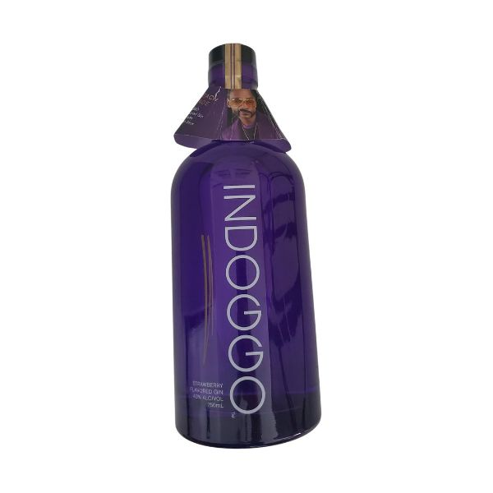
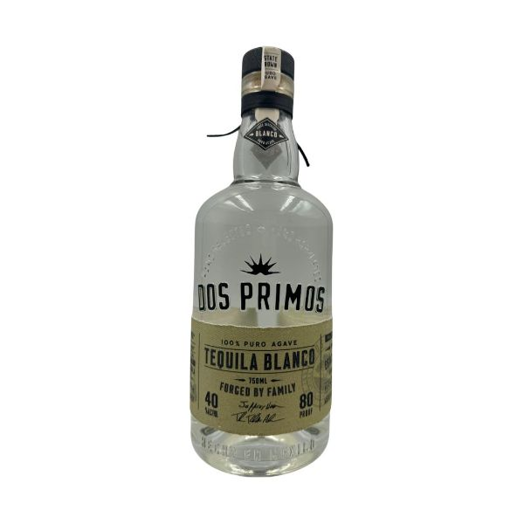
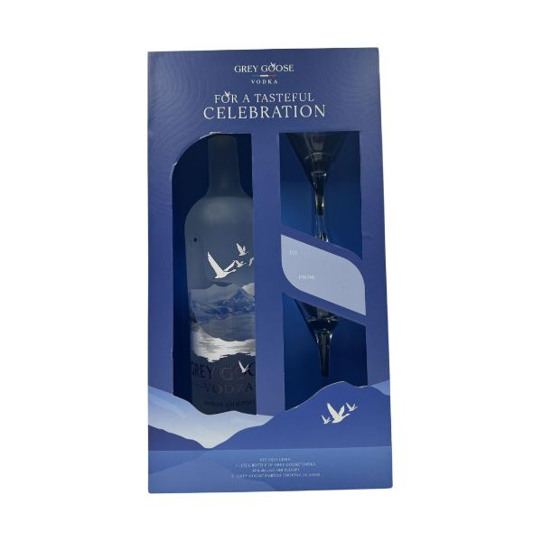
Alcohol launches with premium claims
Indoggo
Strawberry Flavored Gin
46% of consumers responded that they likely or definitely would buy this product, significantly outperforming its subcategory.
Dos Primos
Tequila Blanco
41% of consumers responded that they likely or definitely would buy this product, significantly outperforming its subcategory.
Grey Goose
Vodka
48% of consumers responded that they likely or definitely would buy this product, significantly outperforming its subcategory.
Read on mintel.com
Notes:
This slide is from Alcoholic Beverage Occasions – US – 2024 (https://clients.mintel.com/content/report/alcoholic-beverage-occasions-us-2024#workspace_SpacesStore_3ec67261-de1a-4743-b605-581d3061cb41)
© 2024 Mintel Group Ltd. All Rights Reserved. Confidential to Mintel.

Slide 57
Global growth in food pairing suggestions
Alcohol launches that contain the word "food" rose 15.7% from 2022-23, as brands try to motivate and inspire mealtime occasions with suggested pairings. While older consumers are more likely to participate in these traditional drinking occasions at a higher rate, including pairings on alcoholic beverages beyond more premium bottles of wine like beer and bagged/boxed wine can feel less overwhelming to younger consumers. Additionally, pairing suggestions that can get creative can inspire more casual occasions like snacking.
Read on mintel.com
Notes:
This slide is from Alcoholic Beverage Occasions – US – 2024 (https://clients.mintel.com/content/report/alcoholic-beverage-occasions-us-2024#workspace_SpacesStore_a9e77c5a-1905-40c3-9987-033a41a1a658)
© 2024 Mintel Group Ltd. All Rights Reserved. Confidential to Mintel.

Slide 58
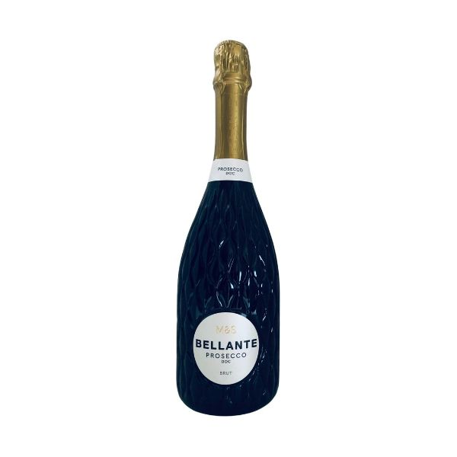
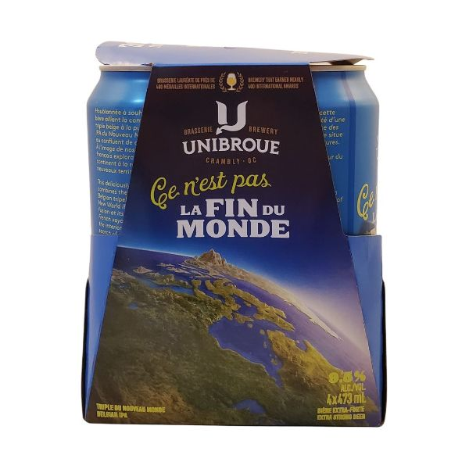
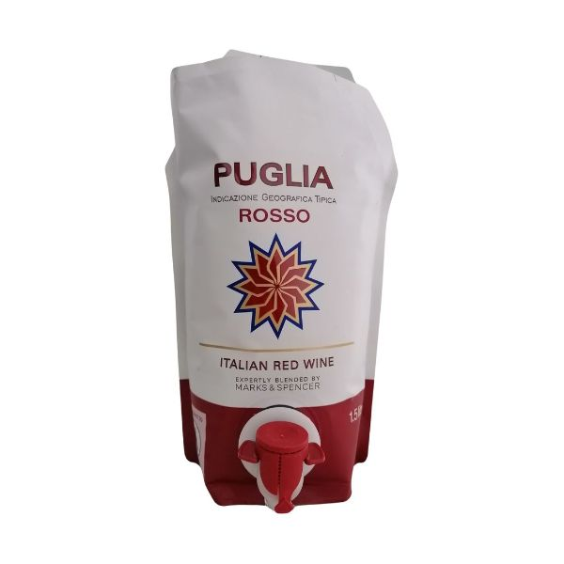
Alcohol beverages with pairing suggestions on pack
M&S (USA)
Bellante Brut Prosecco DOC Wine
"This sparkling prosecco is delicious as an aperitif with party foods."
Unibroue (Canada)
Ce N'est Pas La Fin Du Monde Belgian IPA
"Food pairing: spicy fish tacos, pineapple upside-down cake, old cheddar."
Marks & Spencer (UK)
Puglia Italian Red Wine
"Food: pizza, pasta, barbecues."
Read on mintel.com
Notes:
This slide is from Alcoholic Beverage Occasions – US – 2024 (https://clients.mintel.com/content/report/alcoholic-beverage-occasions-us-2024#workspace_SpacesStore_877dcc19-222b-4919-bd4f-fe7b08ef94c0)
© 2024 Mintel Group Ltd. All Rights Reserved. Confidential to Mintel.

Slide 59
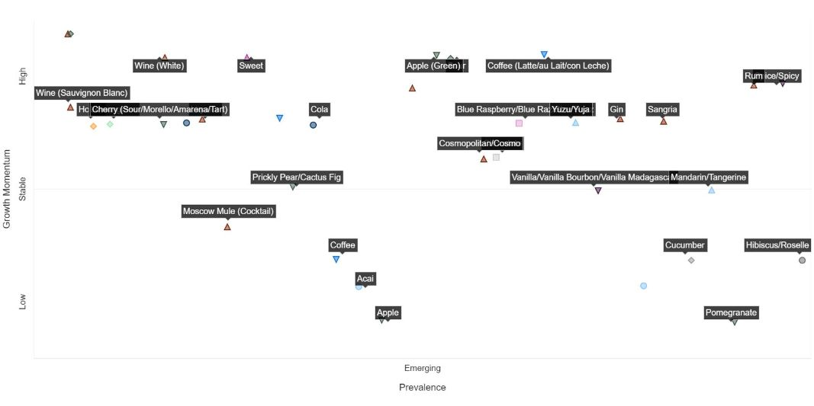
Emerging flavors in alcohol borrow from popular beverages
The prevalence of both non-alcoholic beverages flavors in the emerging landscape of flavored alcoholic beverages (largely made up of RTD beverages) and their positive consumer reception suggests that this category is successfully paving the way for fun and bending the rules of how consumer perceive flavor. Overlapping beverage types and flavors extend and reinvent occasions, making beverages feel more fluid across ABV and format.
US: emerging flavors in flavored alcoholic beverages
Source: Mintel Flavourscape AI
Read on mintel.com
Notes:
Source: Mintel Flavourscape AI [1]
[1] https://clients.mintel.com/scapes/flavourscape/landscape?searchTerms=woPCqGNhdGVnb3J5wpHCvUZsYXZvdXJlZCBBbGNvaG9saWMgQmV2ZXJhZ2VzwqbEkmdpb27CkcKjVVNBwqdmxI3Ej8SRwpA
This slide is from Alcoholic Beverage Occasions – US – 2024 (https://clients.mintel.com/content/report/alcoholic-beverage-occasions-us-2024#workspace_SpacesStore_159af958-7efb-4898-8834-4d75b4b720d1)
© 2024 Mintel Group Ltd. All Rights Reserved. Confidential to Mintel.

Slide 60
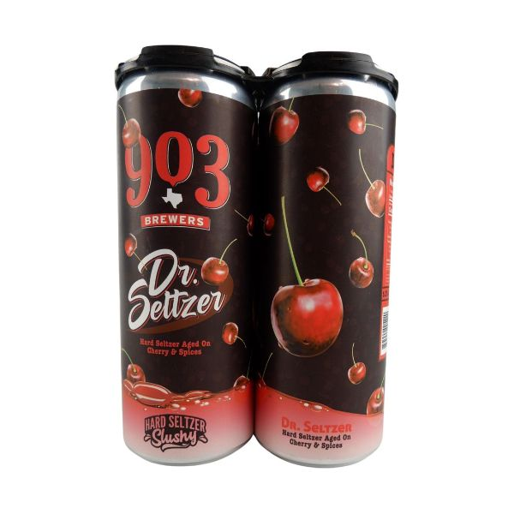
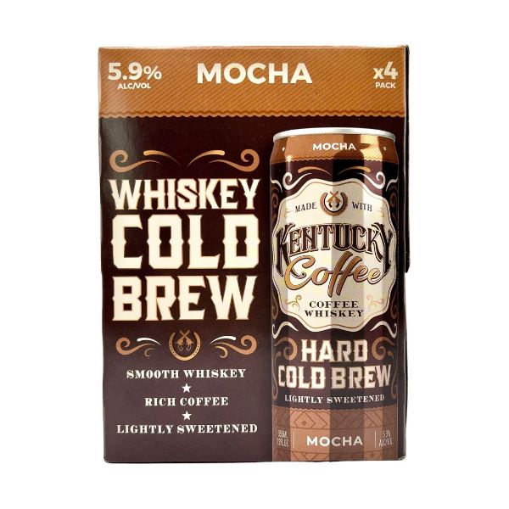
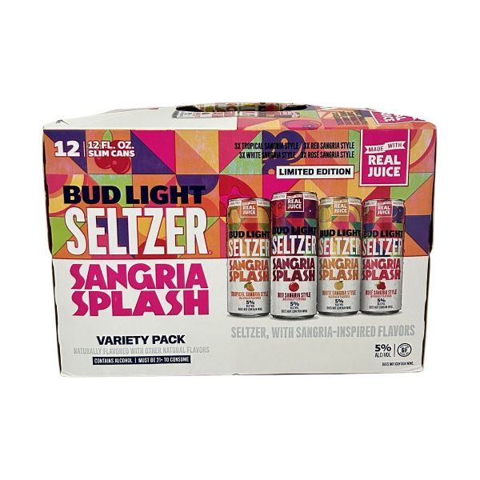
Alcoholic beverages with emerging flavors
903 Brewers
Dr. Seltzer Hard Seltzer Slushy
46% of consumers responded that they likely or definitely would buy this product, significantly outperforming its subcategory.
Kentucky Coffee
Mocha Coffee Whiskey Hard Cold Brew
45% of consumers in our panel responded that they likely or definitely would buy this product, outperforming its subcategory.
Bud Light Seltzer
Sangria Splash Variety Pack
42% of consumers in our panel responded that they likely or definitely would buy this product, outperforming its subcategory.
Read on mintel.com
Notes:
This slide is from Alcoholic Beverage Occasions – US – 2024 (https://clients.mintel.com/content/report/alcoholic-beverage-occasions-us-2024#workspace_SpacesStore_68fa65b7-0ad8-4886-ad89-4c080c64f75e)
© 2024 Mintel Group Ltd. All Rights Reserved. Confidential to Mintel.

Slide 61
Interpreting the map US: emerging flavors in flavored alcoholic beverages, 2024
The previous flavor landscape map showcases emerging flavors in energy drinks on Mintel GNPD for the USA.
Methodology: analysis based on GNPD launches of energy drinks in the USA. Product launches are aggregated by flavors and plotted for prevalence* and growth momentum**.
* we calculate market prevalence (MP) by looking at the raw count of launches over 10+ years with heavier weight on recent years. The higher the MP ranking, the more products on the shelf containing this flavor.
** we calculate growth momentum (GM) over five years. This is not necessarily a linear path. Recent years are weighted more heavily. The higher the GM, the more confident we are that the trend will continue.
Read on mintel.com
Notes:
This slide is from Alcoholic Beverage Occasions – US – 2024 (https://clients.mintel.com/content/report/alcoholic-beverage-occasions-us-2024#workspace_SpacesStore_002045b9-e5ef-462a-bbae-f5a91951d6f9)
© 2024 Mintel Group Ltd. All Rights Reserved. Confidential to Mintel.

Slide 62
Marketing and advertising
Read on mintel.com
Notes:
This slide is from Alcoholic Beverage Occasions – US – 2024 (https://clients.mintel.com/content/report/alcoholic-beverage-occasions-us-2024#workspace_SpacesStore_e457b299-ce94-4ef5-9c74-53ff3868f9b5)
© 2024 Mintel Group Ltd. All Rights Reserved. Confidential to Mintel.

Slide 63
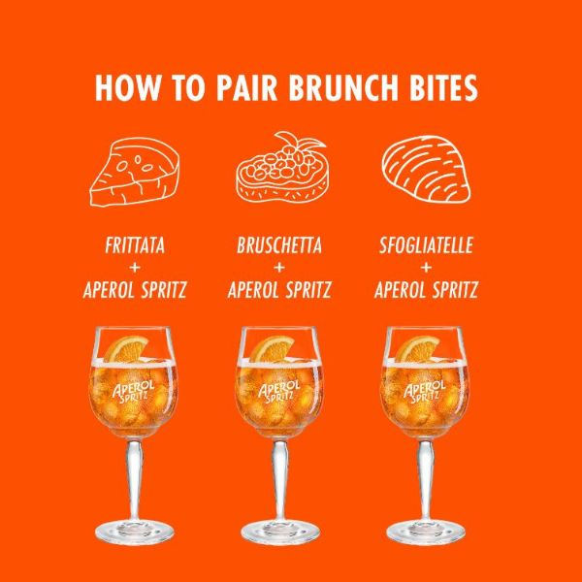
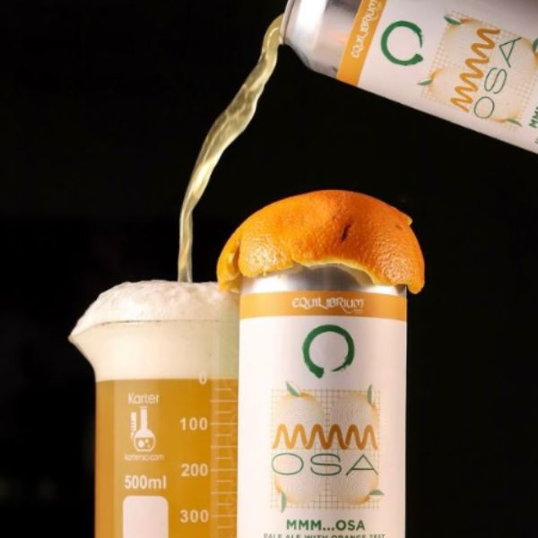
Brunch is reviving beer and wine (with the help of friends)
Younger consumers are more flexible in their preferences for drinking dayparts and brunch has become a daytime occasion where beer and wine can shine. Sparkling wine already feels more fun to younger consumers and the pop of color Aperol brings has made the cocktail a patio staple. Beer is also embracing brunch, borrowing from citrusy breakfast classics like mimosas.
Aperol featuring brunch pairings
Equilibrium Brewery's Mmm...osa pale ale with orange zest
Read on mintel.com
Notes:
This slide is from Alcoholic Beverage Occasions – US – 2024 (https://clients.mintel.com/content/report/alcoholic-beverage-occasions-us-2024#workspace_SpacesStore_597dd38e-f127-4b35-8a3c-12caa0f1a846)
© 2024 Mintel Group Ltd. All Rights Reserved. Confidential to Mintel.

Slide 64
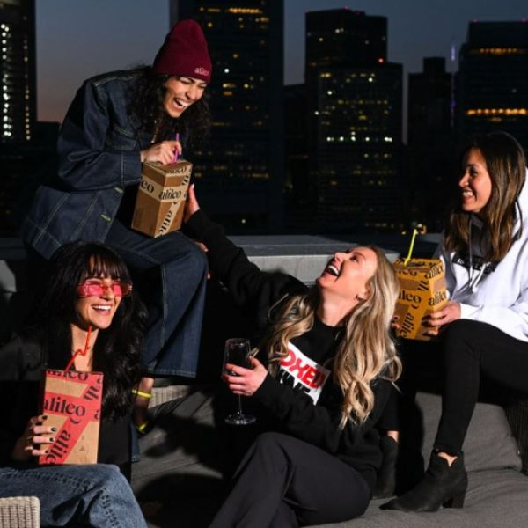
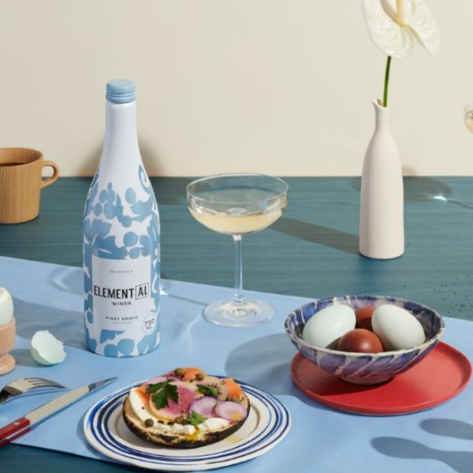
Fun follows format
Brands are leaning into younger consumers' consideration of fun when it comes to alcoholic beverages. While wine has not scored as high in this attribute, formats that break from tradition can connect with consumers who have found fun and convenience in market rock stars like RTDs. The portability of a smaller sized box wine or aluminum full bottle put less retractions on where consumers can have fun.
Alileo launches 1.5L boxed wine
Bogle launches Element(AL) wine in 750ml aluminum bottles
Read on mintel.com
Notes:
This slide is from Alcoholic Beverage Occasions – US – 2024 (https://clients.mintel.com/content/report/alcoholic-beverage-occasions-us-2024#workspace_SpacesStore_452914aa-6547-4190-b703-e9faffb7f4d3)
© 2024 Mintel Group Ltd. All Rights Reserved. Confidential to Mintel.

Slide 65
Opportunities
Read on mintel.com
Notes:
This slide is from Alcoholic Beverage Occasions – US – 2024 (https://clients.mintel.com/content/report/alcoholic-beverage-occasions-us-2024#workspace_SpacesStore_c024e8f3-5c1f-4a12-ba52-e92cd91d2068)
© 2024 Mintel Group Ltd. All Rights Reserved. Confidential to Mintel.

Slide 66
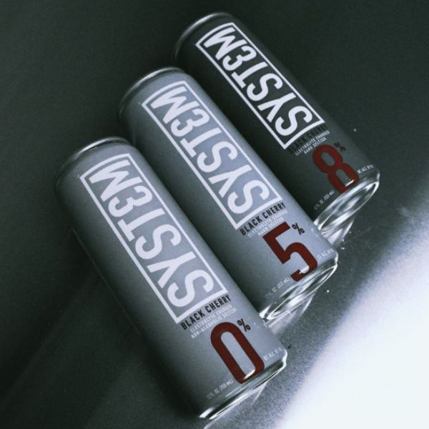
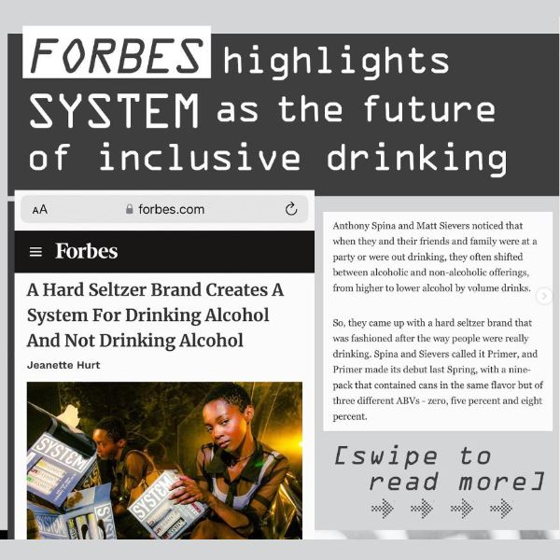
Multipacks with a range of ABVs can expand occasions
Consumers are not looking for a one size fits all when it comes to alcohol, as it is clear that occasions drive choice, however, allowing consumers options in one purchase can motivate brand trial and loyalty. Millennials in particular are looking for both low and high ABV options that can meet a range of moods and needs, not only for a single consumer but for a group of friends or someone hosting an event to ensure no preference is left untouched.
System Seltzers offers zero proof and beyond
"Inclusive drinking"
Read on mintel.com
Notes:
This slide is from Alcoholic Beverage Occasions – US – 2024 (https://clients.mintel.com/content/report/alcoholic-beverage-occasions-us-2024#workspace_SpacesStore_89b73369-8261-4f8d-af32-58fb9190d532)
© 2024 Mintel Group Ltd. All Rights Reserved. Confidential to Mintel.

Slide 67
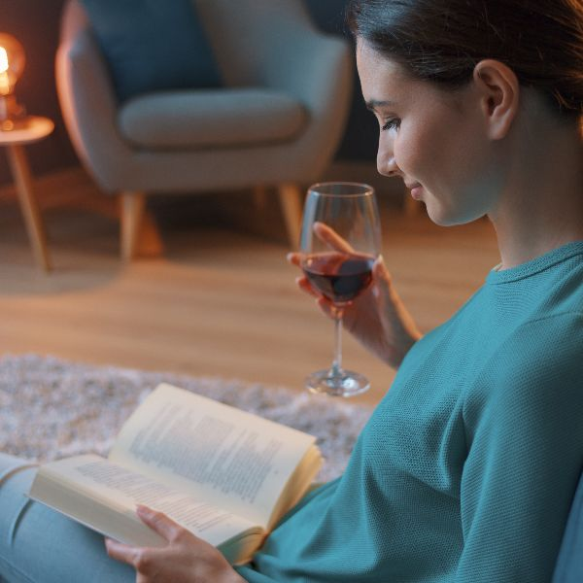
Pairing suggestions can move beyond food, to consumer hobbies
Consumer alcoholic beverage choices and their preferred at-home drinking activities are highly connected and brands have the opportunity to capitalize on these connections when making marketing and product development decisions. For example, a boxed wine marketed to bring to book club could help refresh the category and appeal to the consumers who are choosing wine while reading. Consumers who are choosing RTDs and doing housework may appreciate a QR code that brings them to the perfect cleaning playlist on Spotify. Getting creative by helping consumers curate occasions can add the extra dose of fun that can be the differentiator when it comes to product choice.
Read on mintel.com
Notes:
This slide is from Alcoholic Beverage Occasions – US – 2024 (https://clients.mintel.com/content/report/alcoholic-beverage-occasions-us-2024#workspace_SpacesStore_aea092b6-cacf-4d08-a1fc-0b008e13f56e)
© 2024 Mintel Group Ltd. All Rights Reserved. Confidential to Mintel.

Slide 68
Find balance when it comes to helping consumers improve their mood
Consumers, especially younger are looking to alcohol to improve mood and ease social interaction and with the rise of alternatives that are highly inclusive of natural, mood boosting ingredients and concern with alcohol's impact on mental health, alcohol brands will need to stay on their toes. Transparency is key, and while alcohol brands should not claim that they are healthier than alternatives, they can connect with the one-quarter of consumers who would be inspired to trial because of functional benefits by including flavors and ingredients that have natural health benefits, make healthy food and mixer pairing suggestions and even recommend and collaborate with NA brands for consumers who are switching during the same occasion.
Read on mintel.com
Notes:
This slide is from Alcoholic Beverage Occasions – US – 2024 (https://clients.mintel.com/content/report/alcoholic-beverage-occasions-us-2024#workspace_SpacesStore_86a93c8f-143e-43af-9fe4-081e68ca6ab1)
© 2024 Mintel Group Ltd. All Rights Reserved. Confidential to Mintel.

Slide 69
Appendix
Read on mintel.com
Notes:
This slide is from Alcoholic Beverage Occasions – US – 2024 (https://clients.mintel.com/content/report/alcoholic-beverage-occasions-us-2024#workspace_SpacesStore_d1ffe33e-b61f-43b5-ac30-43dbd9a288e6)
© 2024 Mintel Group Ltd. All Rights Reserved. Confidential to Mintel.

Slide 70
Consumer research methodology
For the purposes of this Report, Mintel commissioned exclusive consumer research* through Kantar Profiles to explore consumer consumption of alcoholic beverages and attitudes and behaviors toward alcoholic beverage occasions. Mintel was responsible for the survey design, data analysis and reporting. Fieldwork was conducted in March 2024 among a sample of 2,000 adults aged 22+ with access to the internet.
Mintel selects survey respondents by gender, age, household income, region, race, ethnicity and parental status so they are proportionally representative of the US adult population using the internet. Mintel also slightly oversamples, relative to the population, respondents who are Hispanic or Black to ensure an adequate representation of these groups in our survey results and to allow for more precise parameter estimates from our reported findings. Please note that Mintel surveys are conducted online and in English only. Hispanic consumers who are not online and/or do not speak English are not included in our survey results.
While race and Hispanic origin are separate demographic characteristics, Mintel often compares them to each other. Please note that the responses for race (White, Black, Asian, Native American or other race) will overlap those that also are Hispanic, because Hispanic consumers can be of any race.
* for further details, see research methodology
Read on mintel.com
Notes:
* for further details, see research methodology
This slide is from Alcoholic Beverage Occasions – US – 2024 (https://clients.mintel.com/content/report/alcoholic-beverage-occasions-us-2024#workspace_SpacesStore_810a9750-d9cf-4f27-8da8-4e5a15c24af2)
© 2024 Mintel Group Ltd. All Rights Reserved. Confidential to Mintel.

Slide 71
Generations
Generation | Overview
World War II/Swing Generation | Born 1928 or earlier (WWII) and 1929-45 (Swing), members of these generations are aged 79+ in 2024.
Baby Boomers | Born 1946-64. In 2024, Baby Boomers are between the ages of 60 and 78.
Generation X | Born 1965-79. In 2024, Gen Xers are between the ages of 45 and 59.
Millennials | Born 1980-96. In 2024, Millennials are between the ages of 28 and 44.
Generation Z | Born 1997-2010. In 2024, members of Gen Z are between the ages of 14 and 27.
Generation Alpha | The newest generation began in 2011. In 2024, members of Gen Alpha are younger than age 14.
In 2021, Mintel made minor adjustments to generational definitions; the size and age of each group may not match previous Reports
Read on mintel.com
Notes:
In 2021, Mintel made minor adjustments to generational definitions; the size and age of each group may not match previous Reports
This slide is from Alcoholic Beverage Occasions – US – 2024 (https://clients.mintel.com/content/report/alcoholic-beverage-occasions-us-2024#workspace_SpacesStore_4e9eac74-01b3-4e58-b3fa-f489243a06a1)
© 2024 Mintel Group Ltd. All Rights Reserved. Confidential to Mintel.

Slide 72
Abbreviations and terms
ABV | Alcohol by volume
AH | At-home
AFH | Away-from-home
GDP | Gross domestic product
GNPD | Global New Product Database
GM | Growth momentum
MP | Market prevalence
NA | Non-alcoholic
A portion of the table is provided; download the full table data here
Read on mintel.com
Notes:
This slide is from Alcoholic Beverage Occasions – US – 2024 (https://clients.mintel.com/content/report/alcoholic-beverage-occasions-us-2024#workspace_SpacesStore_dd949f48-e001-47a5-b7bc-195e14a715d3)
© 2024 Mintel Group Ltd. All Rights Reserved. Confidential to Mintel.

Slide 73
Sydney Riebe
Analyst - US Food and Drink
sriebe@mintel.com

